Slide 1



ABAP on Hana s/4 Hana Training
Day 14
contact@anubhavtrainings.com

Slide 2

Agenda – Day 14
Making CDS DCL ( Authorization and Secure Programming )
Understanding CDS Security
Define CDS Table Functions
Implementation of CDS Table Function
S/4HANA Embedded Analytics
Query Browser
ALP (Analytic List Page )
OVP (Overview Page )

Slide 3
CDS Data Control Language ( DCL )
Declarative approach instead of coded
Based on CDS modeling objects and therefore part of the data-model
Authorizations are also pushed down to DB by extending the Open SQL SELECT statement
Authorizations are only defined once and automatically (re-) used everywhere
Classical approach
DCL approach
PFCG
<Code>
PFCG
<Code>
DCL
SQL
&
SQL
ABAP Authorization Check
CDS View
<Code>
<Code>

Slide 4





Authorizations for CDS Views
All CDS views which expose sensitive or data privacy and protection relevant data must be secured.
Access restrictions on record level are expressed by roles in the Data Control Language (DCL).
Authorization enforcements of DCLs are automatically applied for direct ABAP SQL selects on their protected CDS views.
Authorization enforcements of DCLs are injected as additional filter criteria.
If multiple DCLs are defined for a single CDS view the access restrictions are combined by a logical OR (i.e. the access is less restricted than defined by the individual DCLs).

Slide 5

Aspect
An aspect can be used to define user-dependent values which can be compared to one or more columns of the data model
PFCG_AUTH aspect is a pre-delivered aspect that links the object model not to a user attribute but to his ABAP PFCG authorizations
USER aspect can be used to compare the current logged on user with column of the date model

Slide 6
Runtime Behavior
During runtime the SELECT statement for a CDS view will automatically be enhanced with the authorization filter.
SELECT … FROM … INTO …
WHERE … AND <Authorization Filter Condition>
Authorization check
ABAP Database Base
Authorization Object
View fields
DCL
DDL CDS view
User Profile

Slide 7
Which DCL Roles are Evaluated When ?
CDS Views
DCL Roles
ABAP Open SQL
SELECT AttributeB,
AttributeA
FROM VIEW_D
VIEW_D
ROLE_D
AttributeB
_VIEW_A.AttributeA
grant select on
VIEW_D …
Effective: ROLE_D
<<select from>>
SELECT AttributeB,
_VIEW_A.AttributeA
FROM VIEW_C
VIEW_C
ROLE_C
Effective: ROLE_A resp. ROLE_C
AttributeB
Association: _VIEW_A
grant select on
VIEW_C …
<<select from>>
VIEW_B
ROLE_B
SELECT AttributeB
FROM VIEW_B
AttributeB
grant select on
VIEW_B …
Effective: ROLE_B
<<association>>
VIEW_A
ROLE_A
AttributeA
grant select on
VIEW_A …

Slide 8

Exercise
CDS Security with DCL.

Slide 9

CDS Table Function
CDS Table Functions allow to use natively implemented database-functions in SAP HANA DB directly from CDS.

Slide 10

Why we need CDS Table Function
CDS is an open extension of classical DDIC views:
Support for AnyDB
Optimal integration into DDIC and ABAP
Supports about 90 % of SQL features
But: no access to specific HANA features
Required: Some scenarios require selective measure (“Breakout Scenario” for HANA-only applications)
Highest performance requirements e.g. with complex calculations
Use of database / analytical engine specific functions required
Open SQL and CDS views do not yet offer functionality to solve the problem

Slide 11
Necessary part of CDS Table Function
Table function definition
Parameter list
Return Parameter
Reference to implementing method
Runtime for table function
Runs stored SQL-script procedure generated from AMDP on database tables
ABAP Managed Database Procedure
SAP HANA Database
DDL Source
AMDP Implementation
Includes SQL-script function body

Slide 12


Key Feature of Table Function
They are implemented in HANA SQLScript via AMDP methods
Signature is defined in DDL source (importing parameters and return columns)
They can be consumed by Open SQL and ABAP CDS like other DDIC artifacts (i.e. DB tables, classical DDIC views, CDS views ...)
The SQLScript implementation is handled by the AMDP framework (lifecycle, tool support, extensibility etc.)
DDL source can be activated before the implementing AMDP method exists.
Exercise
CDS Table Function Code

Slide 13
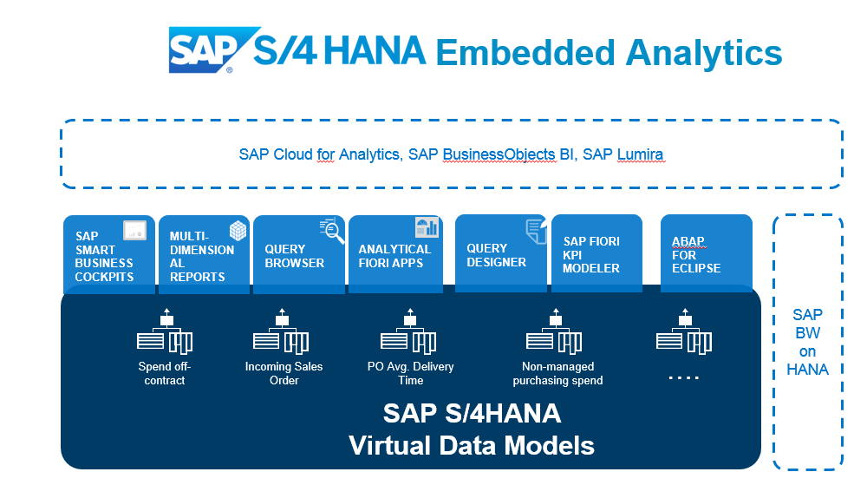
Embedded Analytics
The embedded analytics in SAP S/4HANA provide real-time insights into transactional data. ... With predefined content – visualized in Fiori – the solution offers a kick-start in operational reporting, without the direct need for a separate reporting platform.

Slide 14
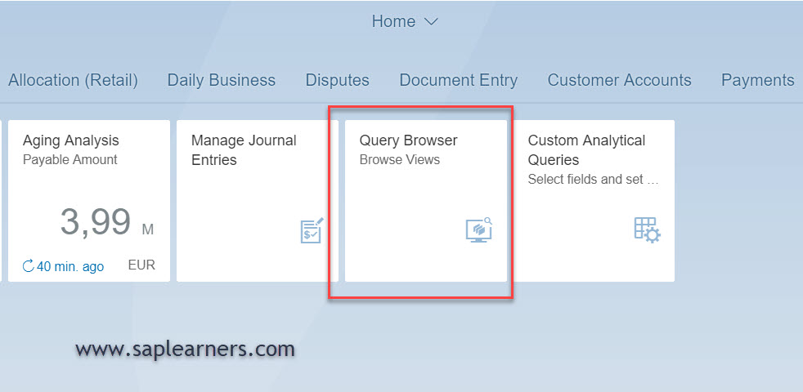
Query Browser
The Query Browser is an SAP fiori application which allows end-user to search for an analytical query and perform ad-hoc reporting on it. The Query Browser is available as a tile in SAP Fiori Launchpad. It displays all the SAP standard analytical queries and custom analytical queries to which the user has access.

Slide 15
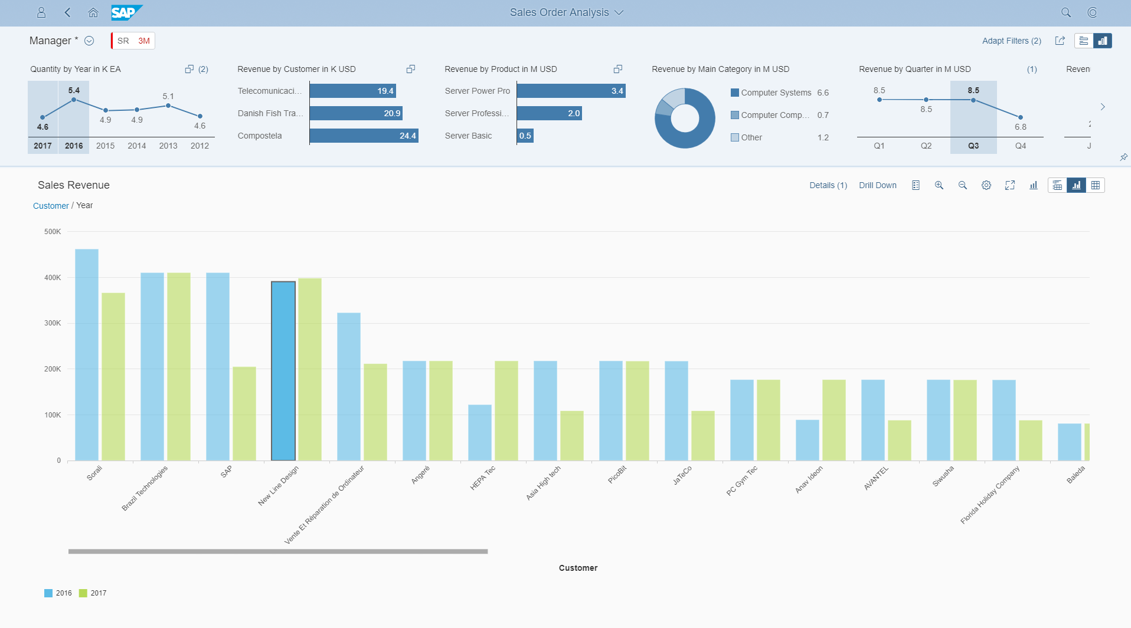
Analytic List Page
Analytical List Page (ALP) is an SAP Fiori elements application for detailed analytics.
ALP lets you analyze data from different perspectives, investigate a root cause, and to act on transactional content. You can identify relevant areas within data sets or significant single instances using data visualization and business intelligence. All this can be done seamlessly within one page.

Slide 16
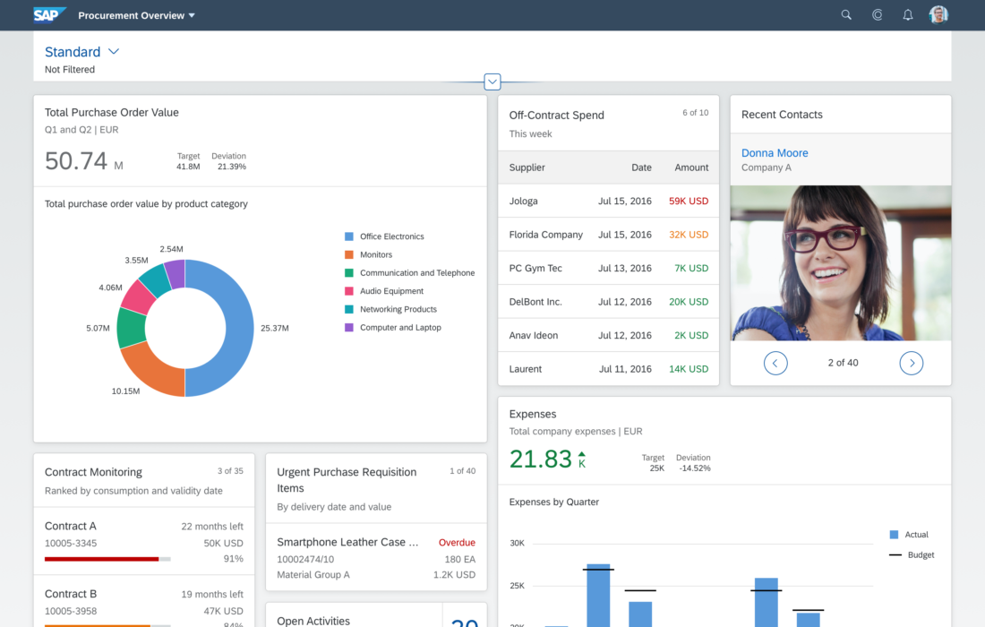
Overview Page ( OVP )
The overview page (OVP) is a data-driven SAP Fiori app type and floorplan that provides all the information a user needs in a single page, based on the user's specific domain or role. It allows the user to focus on the most important tasks, and view, filter, and react to information quickly

Slide 17

End of Day 14
Trainer: Anubhav Oberoy

Slide 18

Trainer: Anubhav Oberoy

Slide 19
THANK YOU
If you cannot do
great things, do small things in a great way.
Anubhav Oberoy
https://www.anubhavtrainings.com

Slide 20


We’re committed to empower you to be
Most Desirable Resource
through powerful training solutions.
We build the workforce of the future.
250+
Corporate Clients
30,000+
Learners Trained
25000+
Learners Placed
FREE WEBINARS
Sign up for free webinars with industry experts every fortnight!
Enroll Now!
Contact us today!
https://anubhavtrainings.com/

Slide 21




More from AnubhavTrainings.com

